Slide 1
Xilinx IP cores for Digital Signal Processing: modelling and RTL simulation
The Advanced Engineering Course
Aleksei Rostov, PhD,
Senior R&D Engineer,
FPGA/Embedded Linux Developer,
aleksei.rostov@protonmail.com

Slide 2
Course Introduction
Sources are available:
https://github.com/farbius/dsp_xilinx_ip
Xilinx IP cores
DDS Compiler
FIR Compiler
LP, BP, HP FIR
Fast Fourier Transform
Decimation Interpolation
Hilbert Transform
FFT
IFFT
Modulation schemes
CIC Compiler
Decimation Interpolation
Xilinx IP cores and DSP algorithms
Lessons structure:
Applications and description of an algorithm (pptx slides)
Math Modelling of an algorithm (Python 3.5)
RTL Simulation of an Xilinx IP core (Verilog, Vivado 2019.1)
aleksei.rostov@protonmail.com

Slide 3
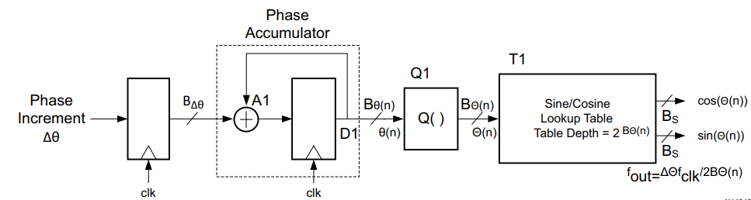
Xilinx IP DDS Compiler (6.0)
RTL Testbench (dds_tb.v)
Task LFM
Task FSK
Task PSK
Task SIN/COS
DDS compiler Applications
up / down converters
demodulation
modulation
Testbench for both configuration: with and without Phase Accumulator
DDS compiler structure
aleksei.rostov@protonmail.com

Slide 4
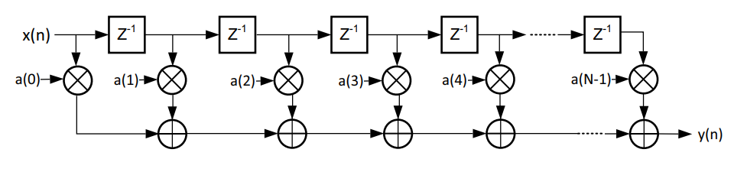
Xilinx IP FIR Compiler (7.2): Low, Band, High pass filters
RTL Testbench (fir_tb.v)
Bandpass
Highpass
Lowpass
FIR compiler application
FIR filters
Decimation / Interpolation
Hilbert Transform
Testbench for FIR filters with loading coefficients via COE files
Convenient FIR filter representation
aleksei.rostov@protonmail.com

Slide 5
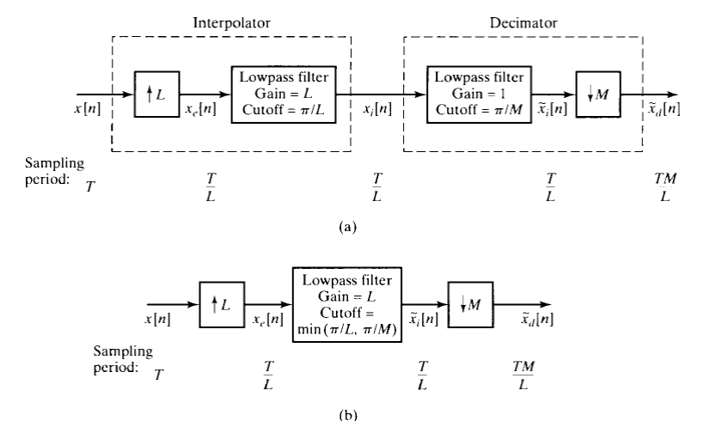
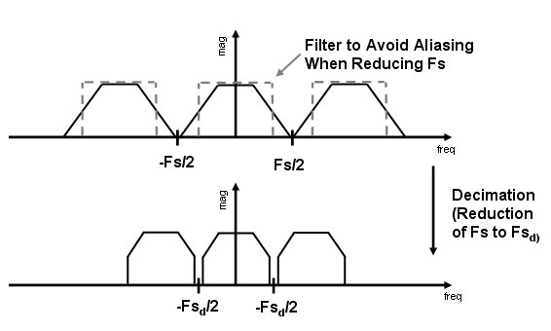
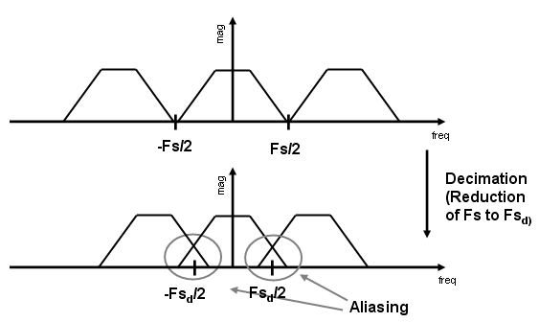
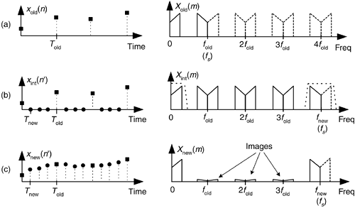
Xilinx IP FIR compiler (7.2), decimation / interpolation
Anti Aliasing Filtering in Decimator
Sample rate conversion by a rational factor:
a) Combination of interpolation and decimation
b) Sample rate converter
RTL Testbench (fir_DecInt_tb.v)
Interpolation
Decimation
Testbench for Decimator and Interpolator with loading coefficients via COE files
a) Low rate signal b) Up sampling c) Interpolation
aleksei.rostov@protonmail.com

Slide 6
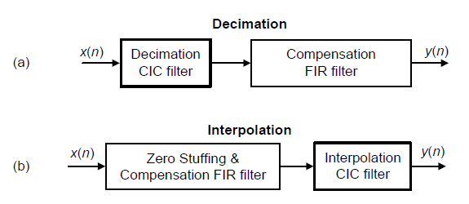
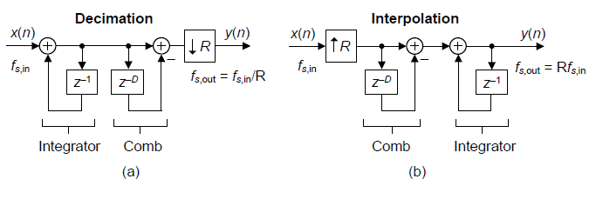
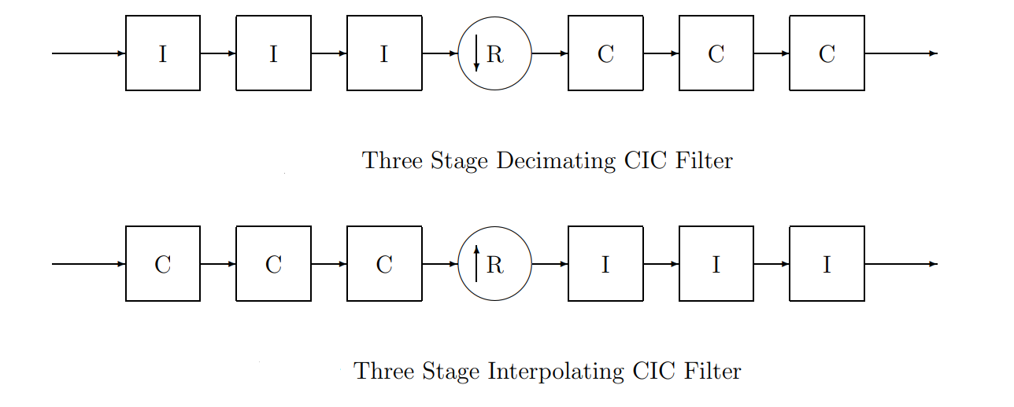
Xilinx IP CIC compiler (4.0), decimation / interpolation
CIC filter applications: (a) for decimation; (b) for interpolation
CIC filter structure: (a) for decimation; (b) for interpolation
RTL Testbench (cic_DecInt_tb.v)
Interpolation
Decimation
Testbench for CIC Decimator and Interpolator
aleksei.rostov@protonmail.com

Slide 7
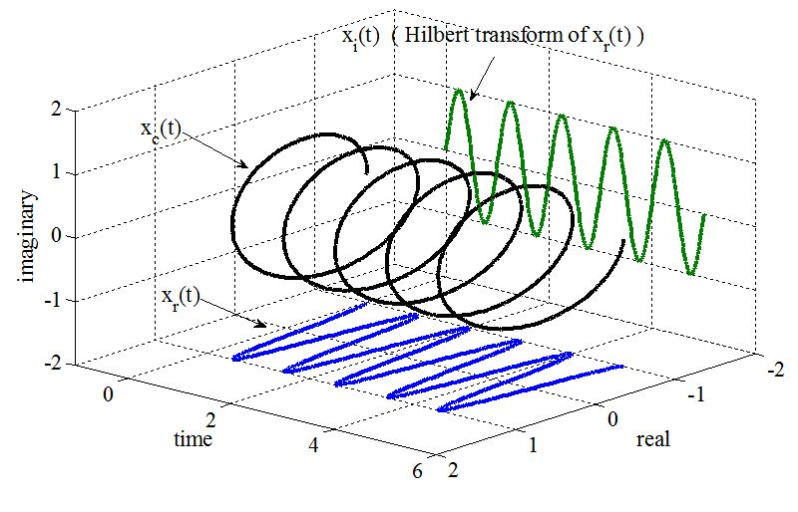
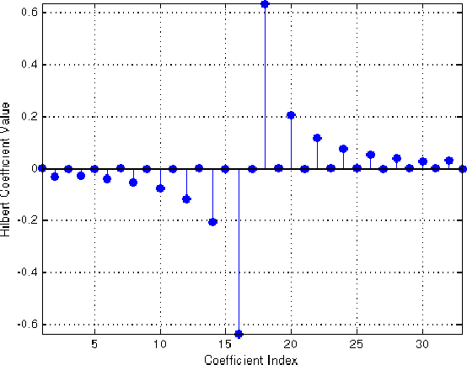
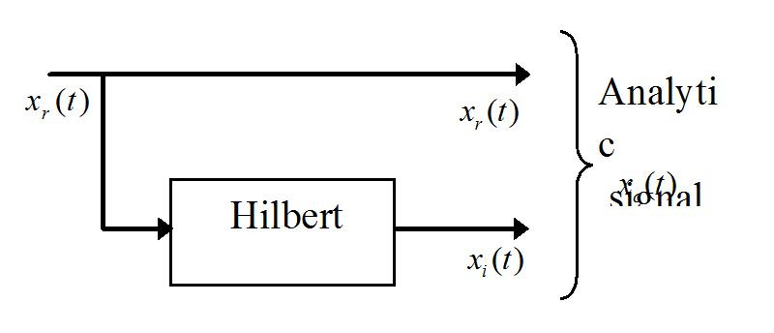
Xilinx IP FIR compiler (7.2): Hilbert Transform
Representation of an analytical signal
Hilbert Transform impulse response
RTL Testbench (hilbert_tb.v)
IQ demodulation
IQ demodulation by using Hilbert Transform
Testbench for Hilbert Transform with FIR Compiler
aleksei.rostov@protonmail.com

Slide 8
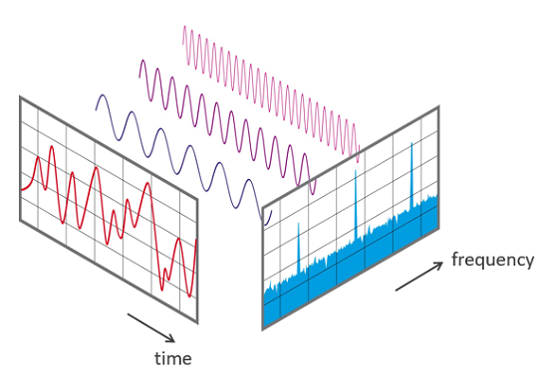
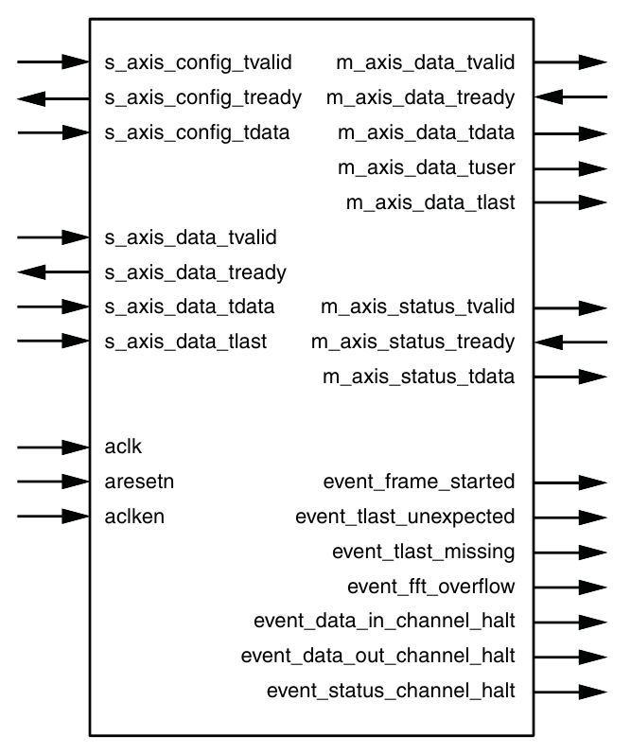
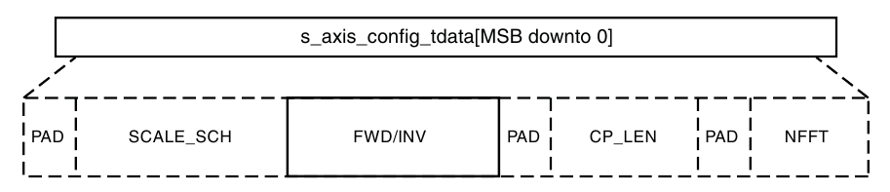
Xilinx FFT IP core: FFT and IFFT
Schematic of the Xilinx FFT IP core
RTL Testbench (fft_tb.v)
Inverse FFT
FFT
Testbench for Xilinx FFT IP core
Configuration word structure
aleksei.rostov@protonmail.com

